Slide 1
Model for Fault Detection and Severity Estimation in Spacecraft Propulsion System
Afifa Puspitasari

Slide 2
Reference:
This model was developed and adapted using the journal titled “Hybrid Approach of XGBoost and Rule-based Model for Fault Detection and Severity Estimation in Spacecraft Propulsion System” as a reference, with several modifications, as they reported achieving a 99.94% accuracy for their testing data and secured second place in the competition.
Link: http://papers.phmsociety.org/index.php/phmap/article/view/3709

Slide 3
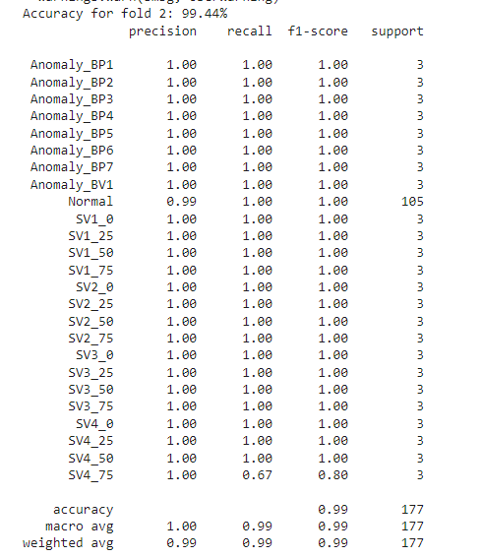

Model Result for Training Model

Slide 4
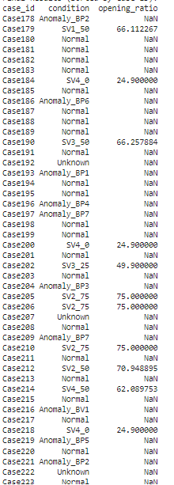
Model Result for Testing Model

Slide 5
Discussion
In the journal, the test data was directly validated in the competition, and no modeling was conducted for the training data, so SMOTE was not applied in their model.
SMOTE was applied to the training data model for oversampling minority classes (classes other than normal) because, even after 5x augmentation as per the journal (resulting in data five times the original size), the data remained imbalanced due to the disproportionately large number of normal class instances.
For the test data model, XGBoost was used with the same parameters as the training model but without SMOTE to remain consistent with the approach used in the original model.
The coefficients obtained in the polynomial regression are different from those in the journal. This is likely because the library I used slightly differs from the approach employed in the journal, which affects the calculation of the opening ratio coefficient. Also, my model still relies on ratios for each valve to assist the regression model in predicting its coefficients.

Slide 6
Discussion
The model trained achieved 99.44% accuracy on fold 2, but the overall k-fold average accuracy remained below 99% at 97.29%. This is because parameter tuning was not yet optimized using GridSearch or other parameter search methods; only manual experimentation was performed, revealing that the learning rate significantly impacts accuracy.
However, the average accuracy can still be considered good because the accuracy comparison between folds is not significantly different, indicating that the model can be considered consistent.
In the feature extraction process conducted, as described in the journal, TSFRESH was utilized. However, this method can still be further developed by selecting the most relevant features to reduce noise from irrelevant ones. Additionally, adding features using other techniques could also be an alternative to improve the model's performance.
Hard voting for test data classification, as done in the journal, has not yet been implemented.
Scoring matrices, as presented in the journal, were not implemented since those were specific to the competition.

